Slide 1

BitBuilders
Problem Statement
Making career choices and AI based counselling accessible to every child at secondary level along with aptitude tests and detailed career paths.
Description
The project team shall establish an interactive AI based model that will help students to choose from careers. The model should handhold student in assessing his capabilities and subsequently help him in deciding a career path.
Problem Statement Title: AI-Powered Career Guidance for Secondary School Students
Theme: Smart Education
Organization: Ministry of Education
Category: Software
Problem Statement Code: SIH1434
Team Leader Name: Harshitha Tadishetty
Institute Code (AISHE): U-0747
Institution Name: Chandigarh University

Slide 2
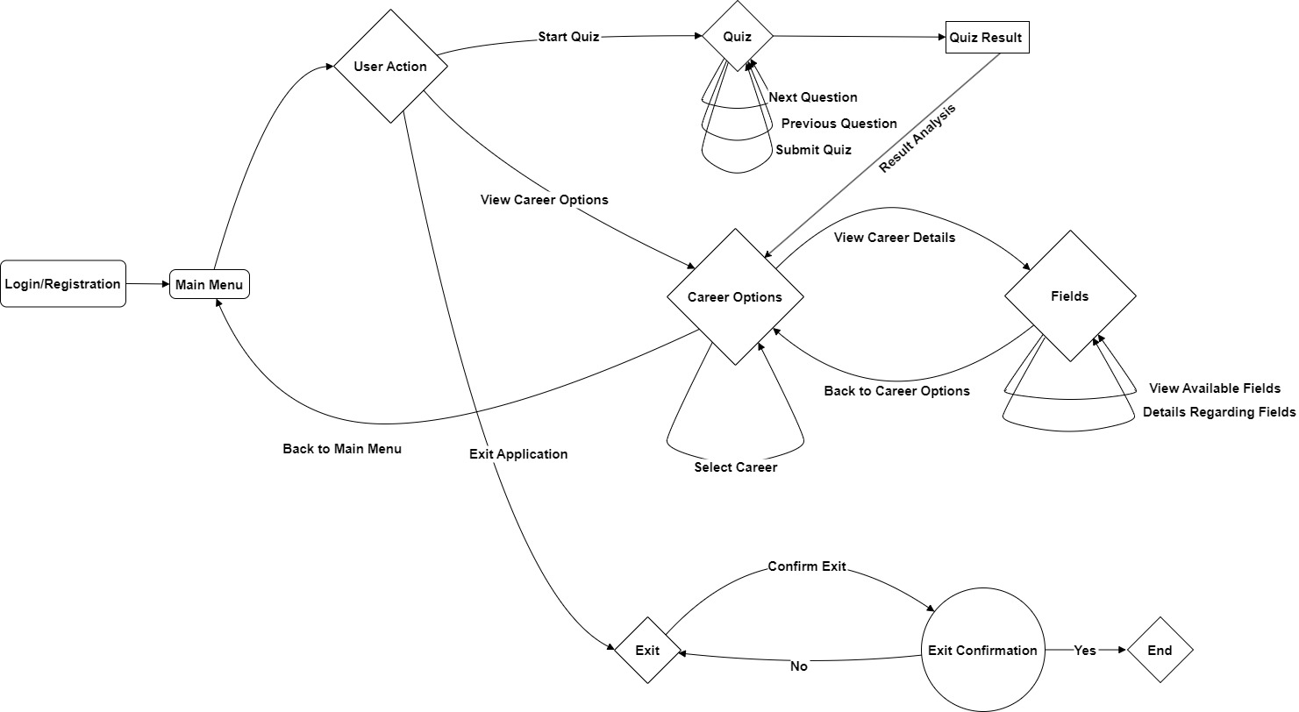
Approach Methodology

Slide 3
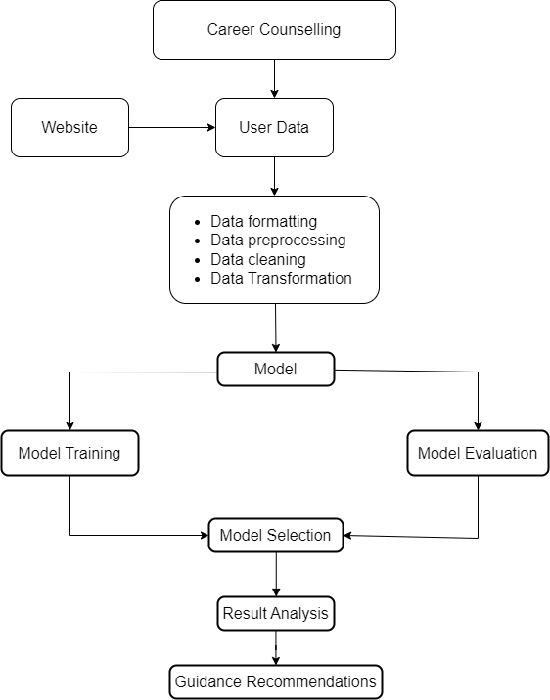
Methodology
Web Application Overview : A web application that utilizes an AI model to assess test results and suggest career options for secondary-level students. Where Users receive a detailed report based on the questionnaire results. The AI model assists users in choosing a career path and provides various options, along with detailed career information.
2. Technology Stack :
Frontend built with React, while Node.js serves as the runtime environment.
Integration of registration, questionnaire, and career portal functionalities.
MongoDB database for storing both user and website data.
Utilizes a RESTful API to fetch and dynamically update data from the database.
3. Machine Learning Model :
The ML model is trained on a dataset comprising more than 15 fields.
The level of questions will increase based on the user's capabilities.
User data is collected, analyzed, and detailed feedback, along with career advice, is provided.
User performance is evaluated based on the difficulty of the questions they successfully answer.
Model accuracy is assessed thoroughly before its selection.
Technology Stack:
Frontend: Mern Stack
Backend: NodeJS, MongoDB, Express
AI/ ML: NumPy, Pandas, TensorFlow, Sklearn
Database: MongoDB

Slide 4
Team Member Details
Team Leader Name: Harshitha Tadishetty
Branch : BTech Stream: CSE Year: III
Team Member 1 Name: Arnav Vikas Gupta
Branch : BTech Stream: CSE Year: III
Team Member 2 Name: Anmol Malik
Branch : BTech Stream: CSE Year: III
Team Member 3 Name: Utkarsh Srivastava
Branch : BTech Stream: CSE Year: III
Team Member 4 Name: Nishtha
Branch : BTech Stream: CSE Year: III
Team Member 5 Name: Ayush
Branch : BTech Stream: CSE Year: III
Team Mentor 1 Name: Savita
Category: Academic Expertise: ML Domain Experience: 6.5 years

